Slide 1

Concept and Management
information system

Slide 2
Learning Objectives
Describe the components of computer-based information systems.
Describe the various types of information systems by breadth of support.
Identify the major information systems that support each organizational level.
Describe strategic information systems (SISs), and explain their advantages.
Describe Porter’s competitive forces and value chain models, and explain how IT helps companies improve their competitive positions.
Describe ﬁve strategies that companies can use to achieve competitive advantage in their industries.
Describe how information resources are managed, and discuss the roles of the information systems department and the end users.

Slide 3
Computer-Based Information Systems (CBIS)
An information system (IS) collects, processes, stores, analyzes, and disseminates information for a speciﬁc purpose.
A computer-based information system (CBIS) is an information system that uses computer technology to perform some or all of its intended tasks.

Slide 4
Components of information systems
Hardware
Software
A Database
A network
Procedures
People

Slide 5
Major Capabilities of IS
Perform high-speed, high-volume, numerical computations.
Provide fast, accurate communication and collaboration within and among organizations.
Store huge amounts of information in an easy-to-access, yet small space.
Allow quick and inexpensive access to vast amounts of information, worldwide.
Interpret vast amounts of data quickly and efﬁciently.
Increase the effectiveness and efﬁciency of people working in groups in one place or in several locations, anywhere.
Automate both semiautomatic business processes and manual tasks.

Slide 6
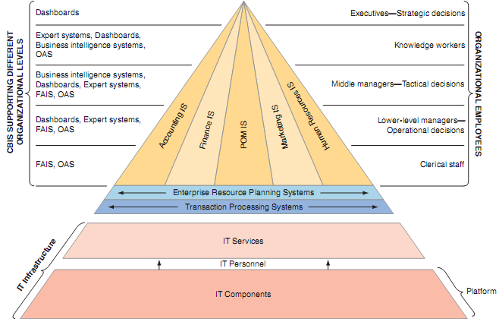
Information Systems within Organizations

Slide 7
IS Support
the organization’s structure
the functions that employees perform within the organization
Information systems tend to follow the structure of organizations, and they are based on the needs of individuals and groups.

Slide 8
IS Support
IS support parts of organizations
FAIS
IS support entire organizations
ERP and Transaction Processing System
IS support groups of organizations.
Supply Chain and ECommerce

Slide 9
Application Programs
An application program is a computer program designed to support a speciﬁc task or business process.

Slide 10
Functional Area Information System (FAIS)
Accounting
Finance
Production/Operation Management
Marketing
Human Resource

Slide 11
Enterprise resource planning (ERP) systems
ERP systems are designed to correct a lack of communication among the functional area ISs.
ERP systems were an important innovation because the various functional area ISs were often developed as standalone systems and did not communicate effectively (if at all) with one another.
ERP systems resolve this problem by tightly integrating the functional area ISs via a common database.
In doing so, they enhance communications among the functional areas of an organization.

Slide 12
A transaction processing system (TPS)
A TPS supports the monitoring, collection, storage, and processing of data from the organization’s basic business transactions, each of which generates data.
The TPS collects data continuously,typically in real and provides the input data for the corporate databases.
The TPSs are considered critical to the success of any enterprise because they support core operations.

Slide 13
Interorganizational Information Systems (IOSs)
IOSs : Information systems that connect two or more organizations.
Supply Chain
Ecommerce

Slide 14
Supply Chain
Describes the ﬂow of materials, information, money, and services from suppliers of raw material through factories and warehouses to the end customers.
Shows physical ﬂows, information ﬂows, and ﬁnancial ﬂows.
Soft Products : Information ﬂows, ﬁnancial ﬂows, and digitizable products
Hard Products : Physical Products

Slide 15
Electronic commerce systems
Enable organizations to conduct transactions, called business-to-business (B2B) electronic commerce, and customers to conduct transactions with businesses, called business-to-consumer (B2C) electronic commerce.
All transactions are typically Internet based.

Slide 16
Support for Organizational Employees
Clerical workers
Lower-level managers
Middle managers
Knowledge workers
Executives

Slide 17
Ofﬁce automation systems (OASs)
OASs support the clerical staff, lower and middle managers, and knowledge workers.
These employees use OASs to develop :
documents (word processing and desktop publishing software),
schedule resources (electronic calendars),
communicate (e-mail, voice mail, videoconferencing, and groupware).

Slide 18
Functional area information systems (FAISs)
FAISs summarize data and prepare reports, primarily for middle managers but sometimes for lower-level managers as well.
Because these reports typically concern a speciﬁc functional area, report generators (RPGs) are an important type of functional area IS.

Slide 19
Business intelligence (BI) systems
BI systems provide computer-based support for complex, non-routine decisions, primarily for middle managers and knowledge workers.
These systems are typically used with a data warehouse and allow users to perform their own data analysis.

Slide 20
Expert systems (ESs)
ESs attempt to duplicate the work of human experts by applying reasoning capabilities, knowledge, and expertise within a speciﬁc domain.
These systems are primarily designed to support knowledge workers.

Slide 21
Dashboards (digital dashboards)
Dashboards support all managers of the organization.
Dashboards provide rapid access to timely information and direct access to structured information in the form of reports.
Dashboards that are tailored to the information needs of executives are called executive dashboards.

Slide 22
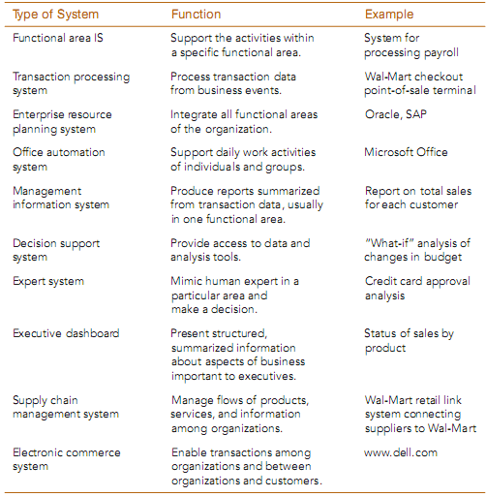
Types of Organizational Information Systems

Slide 23
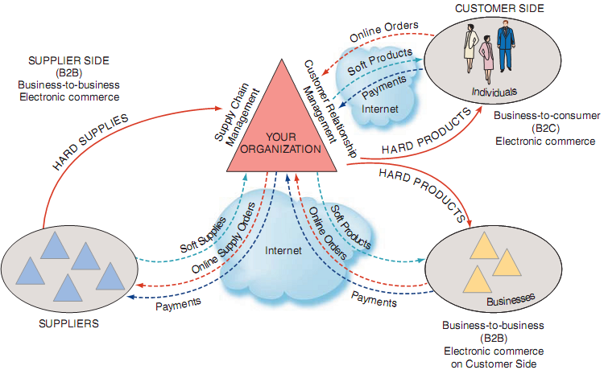
Information Systems outide Organizations

